Slide 1
Activity 1: Stress Charting
High
Stress
Level
Low
15
0
Days Left

Slide 2
Activity 1: Stress Charting
Project | Quality | Role
Name of Project | [S]Success [F] Failure | [C] – Champion (all roles) [D] – Dev [W] – Writer (no coding) [M] – Moral Support only [S] – Stress giver; No contribution

Slide 3
Activity 1: Reflection
What does your stress chart show about your productivity?
What’s your success rate? (# of successes/ total # of projects)

Slide 4
Software Engineering
Introduction

Slide 5

Transition from Amateur

Slide 6

To Professional

Slide 7
Class Survey: Success Rate
100% ?
90% ?
80% ?
65% ?
50% ?
Below ???

Slide 8
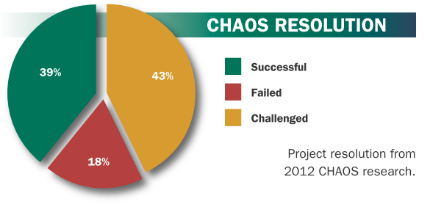
Industry Success Rate

Slide 9
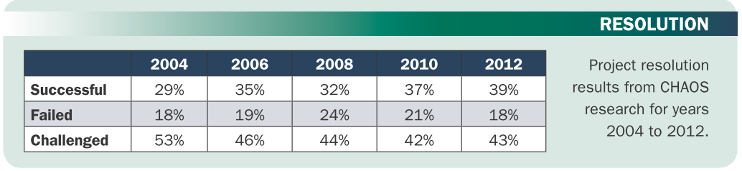
Industry Success Rate
Notes:
Coming back to the Chaos Report 2006, the thing that doesn’t change significantly over all those years is percentage of projects with time or budget overrun. It still oscillates around 50%

Slide 10
Industry Definition of “Success”
Successful (delivered on time, on budget, with all required features and functions)
Challenged (late, over budget, and/or with less than the required features and functions)
Failed (cancelled prior to completion or delivered and never used)
Notes:
If we follow the definition of a truly successful project, can you still consider your projects successful? If yes, is it adopted by users?

Slide 11
What can go wrong in a software project?
Notes:
To understand this phenomenon, we have to look at what can go wrong in a software project. Can you guess identify some of the possible problems?

Slide 12
Nightmares of Software Dev’t
The final Software does not fulfill the needs of the customer.
Bad quality: frequent errors, hard to use, ...
Delayed and/or over-budget
Hard to extend and improve: if you want to add a functionality later is mission impossible.
Bad documentation
Notes:
i. The final Software doesn´t fit the needs of the customer
ii. Hard to extend and improve: if you want to add a functionality later is mission impossible
Bad documentation, bad software design
iii. Bad quality: frequent errors, hard to use...
iv. More time and costs than expected

Slide 13
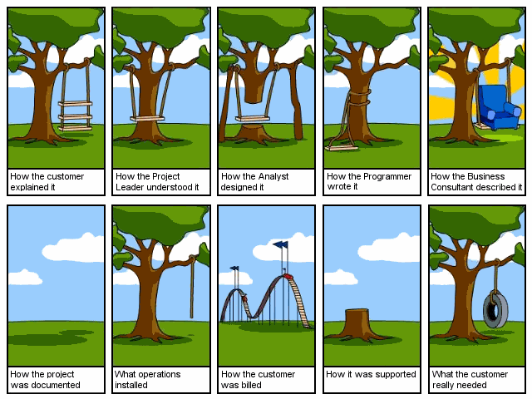
Notes:
This comic quite captures one of the causes of problems in software development: misunderstanding the requirement.

Slide 14
So, what happens if a software fails?
Notes:
To understand this phenomenon, we have to look at what can go wrong in a software project. Can you guess identify some of the possible problems?

Slide 15
No biggie?
7 deaths of cancer patients were due to overdoses of radiation resulting from a race condition between concurrent tasks in the Therac-25 software.
Computer blunders were blamed for $650M student loan losses (from ACM SIGSOFT )
In October 1995, 200,000 French civil servants were paid twice. (Niiiiiice.)

Slide 16
Ariane 5 Flight 501
Let’s watch the video
What do you think caused the disaster?

Slide 17
Programming is NOT enough!
It is not enough to do your best. You must first know what to do and THEN you can give your best.
-- W. Edwards Deming
Know the best practices of seasoned developers.

Slide 18
And since…
A clever person solves a problem. A wise person avoids it.
- Albert Einstein
Best way to improve chances of project success? Avoid as many problems as you can.

Slide 19
We need to learn Software Engineering.
The point is…

Slide 20
Software: What is it?
A set of computer programs and associated documentation (requirements, design models, test cases, user guides) (Sommerville, 2004)
Not just the program or the code ☺
Notes:
In simple terms, is the study and application of methodologies to develop quality software that fulfill customer needs.

Slide 21
Software: What is it REALLY?
A Solution
Unless you solve a problem and make a difference, it’s just a set of code.

Slide 22
Engineering: What is it?
the design and building of complex products (Merriam-Webster)
Notes:
In simple terms, is the study and application of methodologies to develop quality software that fulfill customer needs.

Slide 23
Software Engineering: What is it?
The application of a systematic, disciplined, quantifiable approach to the development, operation, and maintenance of software, and the study of these approaches; that is, the application of engineering to software.
----From good ‘ol Wikipedia
Notes:
In simple terms, is the study and application of methodologies to develop quality software that fulfill customer needs.

Slide 24
Activity 2: Analogy
Let’s watch the video
What is the guy saying our usual way of plating a pasta dish?
Is there anything wrong with how we usually plate?
Now, think of the pasta as your previous software projects. How do you usually develop it?
Notes:
Just like how this simple video shows, the RIGHT way of doing things make a difference. The same principle applies to making software.

Slide 25
Software Engineering is
How to create high QUALITY software in the least amount of TIME and EFFORT possible?
Notes:
In simple terms, is the study and application of methodologies to develop quality software that fulfill customer needs.

Slide 26
Software Engineering
SUCCESS
=
QUALITY + PRODUCTIVITY
We’re also concerned that developers have proper sleep and social life while building software.
Notes:
A successful project is one that produces a software with high quality with the highest productivity (on time and budget).

Slide 27
Software Engineering
Objective: To produce software that is
On time: is delivered at the established date.
Reliable: doesn´t crash.
Complete: good documentation, fulfill customer needs.
Notes:
On time: deliver at the established date
Reliable: doesn´t crash often, etc
Complete: good documentation, fulfill customer needs

Slide 28
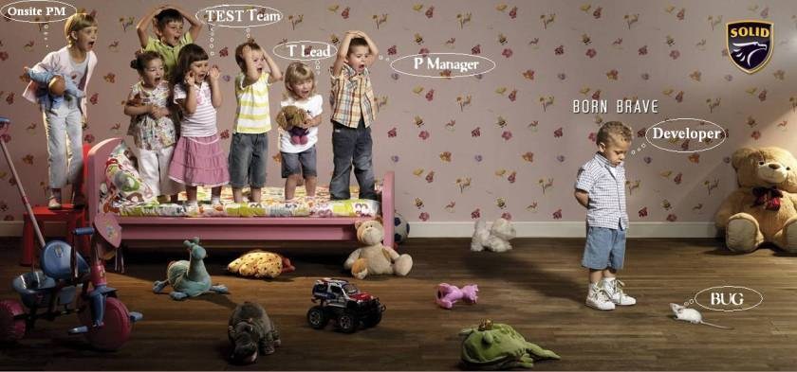
The Team

Slide 29
Stages of Software Development
Requirements Engineering
Software Design
Software Verification & Validation
Software Construction
Software Maintenance

Slide 30
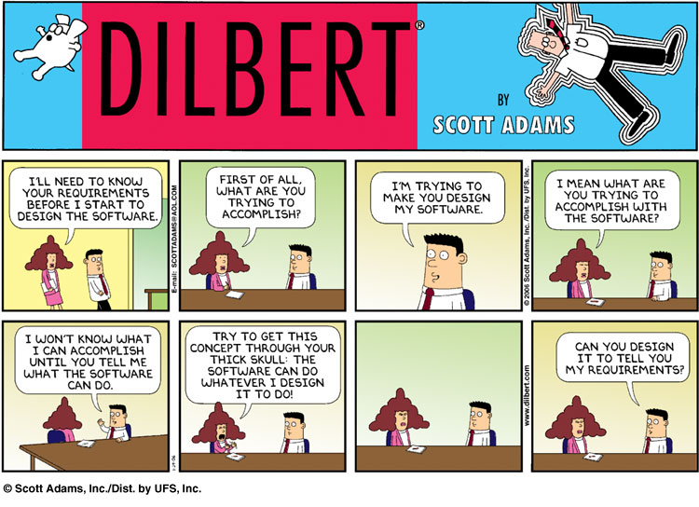
Requirements Engineering
Find out what the client want the software to do
Notes:
Find out what the client want the software to do

Slide 31
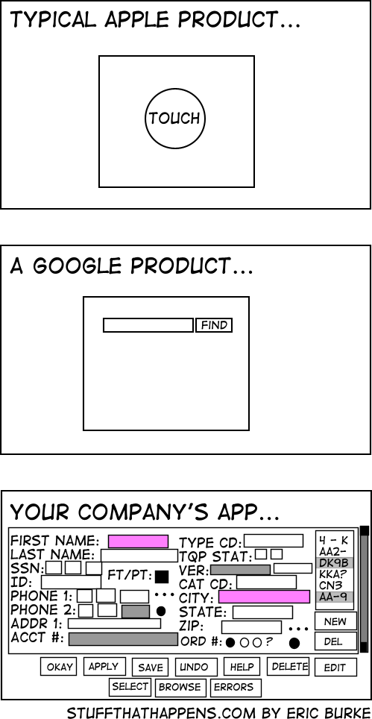
Software Design
Planning the software solution
Notes:
How are you going to build your application and how will it be

Slide 32
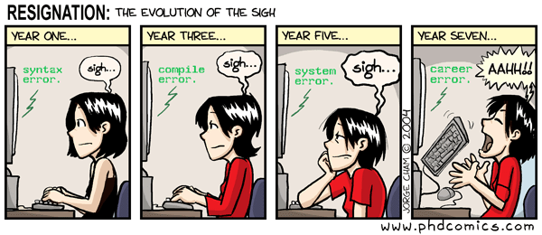
Software Construction
Notes:
Code!!!

Slide 33
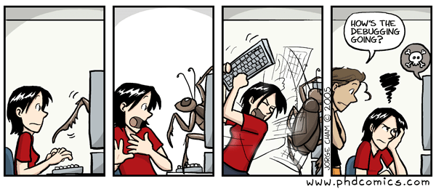
Software Verification & Validation
4. Testing
Executing the application trying to find software bugs
Notes:
Try everything to make sure is working correctly
Test techniques include, but are not limited to, the process of executing a program or application with the intent of finding software bugs

Slide 34
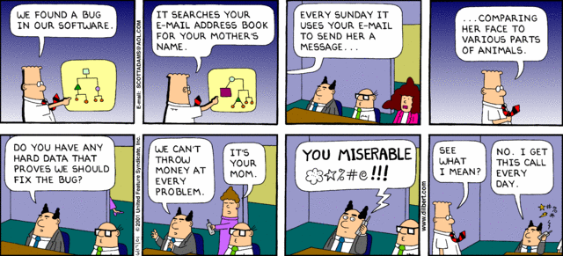
Software Maintenance
Any activity oriented to change an existing software product.
Notes:
Maintenance and enhancing software to cope with newly discovered problems or new requirements can take far more time than the initial development of the software. It may be necessary to add code that does not fit the original design to correct an unforeseen problem or it may be that a customer is requesting more functionality and code can be added to accommodate their requests. It is during this phase that customer calls come in and you see whether your testing was extensive enough to uncover the problems before customers do.
Software maintenance activities include any software engineering activity oriented to change an existing software product or to improve or plan for future changes.

Slide 35
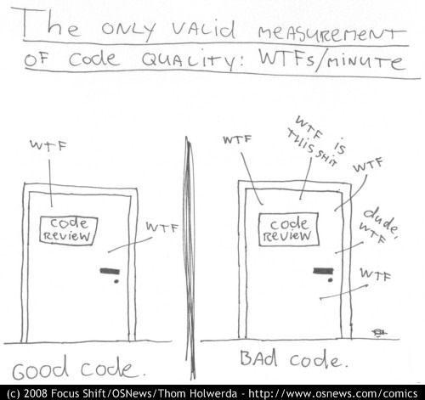

Slide 36
References
http://upload.wikimedia.org/wikipedia/commons/thumb/a/a2/Avianca_767-200_at_El_Dorado.JPG/800px-Avianca_767-200_at_El_Dorado.JPG
http://www.nosoloviajeros.com/imagenes/colombia/transmilenio.jpg
http://files.nireblog.com/blogs1/keniecita/files/celular-2.jpg
http://www.fayerwayer.com/up/2008/06/iphone3g.jpg
http://www.slideshare.net/soreygarcia/ingenieria-de-software-para-dummies
http://www.projectsmart.co.uk/docs/chaos-report.pdf
http://www.evilaliens.com/images/software_engineering_explained.gif
http://sunnyday.mit.edu/accidents/Ariane5accidentreport.html
http://stackoverflow.com/questions/84556/whats-your-favorite-programmer-cartoon
http://stuffthathappens.com/blog/2008/03/05/simplicity/
http://www.troyangrignon.com/dilbertsoftwarerequirements.jpg
http://www.phdcomics.com/comics/archive/phd120804s.gif
http://www.phdcomics.com/comics/archive/phd011406s.gif
http://search.dilbert.com/comic/Software%20Bugs

Slide 37
Who am I?

